Slide 1
Data Mining Lecture 9

Slide 2
Table of Contents
Correlation Rules 3-4
Advanced Pattern Mining 5-7
Data types: Categorical & Quantitative 8
Mining Numerical Quantitative Associations 9
Constraint-Based Mining 10
Classes of Constraints 11
Metarule-Guided Mining 12
Anti-Monotonicity in Constraints 13
Monotonic Constraints 14
Succinctness & Pre-Counting Prunable 15
Convertible Constraints 16
Interview Question 17-20
Law of Large Numbers 21
Curse of Dimensionality 22
Bayes’ Theorem and Prior Knowledge 23
Elgenvalues and Elgenvectors in Dimensionality Reduction 24
Jacard Similarity for Set Comparisons 25

Slide 3
Correlation Rules
Introduction:
Correlation rules identify relationships between two or more variables in a dataset.
They provide insights into how different variables interact or co-occur.
Core Concepts:
Definition: A correlation rule is of the form A↔BA↔B, which implies that the presence of A is correlated with the presence of B and vice versa.
Support: Refers to the proportion of transactions in the dataset that contain both AA and BB.
Confidence: Measures the likelihood that the presence of A implies the presence of B.
Lift: A value that indicates the strength of a rule over the randomness. A lift value greater than 1 suggests that A and B are more likely to be bought together than if they were bought individually.

Slide 4
Correlation Rules
Examples:
Market Basket Analysis: If bread and butter are often bought together, it can lead to the rule "bread"↔"butter""bread"↔"butter".
Health Data: Observing that patients with high blood pressure often have high cholesterol levels, leading to a rule "high BP"↔"high cholesterol""high BP"↔"high cholesterol".
Significance:
Correlation rules help in unveiling hidden patterns in large datasets.
Useful for marketers to understand purchasing behavior, doctors to identify related symptoms, and many other professionals to uncover related events or attributes.
Limitations:
Correlation does not imply causation. Just because two variables are correlated doesn't mean one causes the other.
It's essential to interpret correlation rules with domain knowledge and context.

Slide 5
Advanced Pattern Mining
Introduction:
Advanced pattern mining aims to extract more intricate and meaningful patterns from data beyond basic associations.
It deals with challenges like high dimensionality, noise, and complex relationships among variables.
Core Concepts:
Sequential Patterns: Mining patterns where the order of events matters. For example, tracking a customer's journey on an e-commerce website.
Graph Patterns: Mining patterns in data represented as graphs. This is particularly useful for social network analysis or protein interaction networks in bioinformatics.
Spatial and Spatio-Temporal Patterns: Patterns related to physical locations and their evolution over time. For instance, analyzing urban growth or the spread of diseases.
Multidimensional Pattern Mining: Analyzing patterns across different dimensions or perspectives of data. Useful in OLAP (Online Analytical Processing) systems where data is seen from various angles.
Colossal Patterns: Mining patterns from extremely large datasets. This requires specialized algorithms and infrastructure.

Slide 6
Advanced Pattern Mining
Techniques & Approaches:
Constraint-Based Mining: Leveraging user-defined constraints to guide the pattern discovery process.
Utility-Based Mining: Focusing on patterns that offer the highest 'utility' or 'value', like the most profitable item combinations in a retail scenario.
Anomaly Detection: Identifying patterns that deviate significantly from expected behavior, which can be crucial in fraud detection or network security.
Challenges:
Scalability: As data grows, the challenge is to mine patterns efficiently without sacrificing quality.
High Dimensionality: Handling datasets with numerous attributes or dimensions.
Noise and Outliers: Filtering out irrelevant or erroneous data to ensure the accuracy of mined patterns.
Interpreting Results: Making sense of complex patterns and translating them into actionable insights.

Slide 7
Advanced Pattern Mining
Applications:
Healthcare: Mining patient records for patterns that predict disease outbreaks or treatment effectiveness.
Finance: Analyzing stock market data to find patterns indicating potential future market movements.
E-Commerce: Finding patterns in customer behavior to optimize marketing strategies or improve user experience.

Slide 8
Data Types: Categorical & Quantitative
Two main categories: Categorical and Quantitative attributes.
Categorical (Nominal) Attributes:
Divided into categories without order or priority.
Examples: color (red, blue, green) and brand (Apple, Samsung, Sony).
Mining Technique: Apriori algorithm.
Quantitative Attributes:
Numerical values with inherent order.
Examples: age, income, price.
Techniques: regression analysis, correlation coefficient, K-means clustering.

Slide 9
Mining Numerical Quantitative Associations
Static Discretization:
Define bins or ranges for variables.
Simple, but may oversimplify data.
Dynamic Discretization:
Data-driven range definitions (e.g., quartiles).
Captures data nuances.
Clustering:
Unsupervised method grouping similar data points.
Discover age-based shopping patterns.
Deviation:
Measures divergence from a norm.
Helps identify issues like gender wage gaps.

Slide 10
Constraint-Based Mining
Navigates vast data for valuable patterns.
User provides constraints based on analysis objectives.
Benefits:
User flexibility: Tailor the mining process.
System optimization: Reduce the search space.
Example: Mining transactions with diapers and baby food for insights on families with young children.
Efficiently handle hybrid datasets with both categorical and quantitative attributes.

Slide 11
Classes of Constraints
Knowledge Type Constraint:
Guidelines on desired knowledge or patterns (e.g., associations, correlations).
Data Constraints:
Focus on specific data sections.
Dimension or Level Constraints:
Hierarchical data granularity control.
Interestingness Constraints:
Subjective criteria based on user/business needs.
Rule or Pattern Constraints:
Direct mining to specific pattern forms.
Metarules guide the rule formation.

Slide 12
Metarule-Guided Mining
Metarules: Rule templates dictating the rule structure.
Rules are formed by substituting metarule variables with dataset attributes/values.
Example: P1(X, Y) ∧ P2(X, W) ⇒ buys(X, “office sw”).
Complex metarules combine multiple predicates.
Identify n-predicate sets in data.
Compute support of all a-predicate subsets.
Compute rule confidence.
Focus on relevant and reliable patterns.

Slide 13
Anti-Monotonicity in Constraints
Definition: If an itemset S doesn't satisfy the constraint, then none of its supersets will either.
Allows for pruning of the search space in mining frequent itemsets.
Example 1: Constraint sum(S.price)≤100sum(S.price)≤100 is anti-monotonic.
Example 2: Constraint sum(S.price)≥100sum(S.price)≥100 is not anti-monotonic.
Example 3: Constraint range(S.profit)≤15range(S.profit)≤15 is anti-monotonic.

Slide 14
Monotonic Constraints
Definition: If an itemset S meets a constraint, then any larger itemset that includes S will also satisfy that constraint.
Allows for streamlined search by focusing on satisfactory itemsets.
Example 1: Constraint sum(S.price)≥100sum(S.price)≥100 is monotonic.
Example 2: Constraint min(S.price)≤100min(S.price)≤100 is monotonic.
Example 3: Constraint range(S.profit)≥15range(S.profit)≥15 is monotonic.

Slide 15
Succinctness & Pre-Counting Prunable
Succinctness: If set S meets/fails a constraint, all its supersets/subsets do the same.
Pre-counting prunable: Determine without exact support counting that a constraint cannot be met.
Efficiently eliminate unnecessary patterns.
Example 1: Constraint sum(S.price)≥100sum(S.price)≥100 is not pre-counting prunable.
Focus on mining relevant patterns efficiently.

Slide 16
Convertible Constraints
Convert non-monotonic or non-anti-monotonic constraints into one or the other by ordering items.
Example: avg(S.profit) ≥ 25 becomes anti-monotonic when items are ordered by descending profit.
Streamline the mining process by focusing on relevant itemsets.
Strongly Convertible: Can be both anti-monotonic and monotonic based on item ordering.
Flexibility in pattern mining.

Slide 17
Interview Question
Given a large dataset of customer transactions from an e-commerce platform, design a system that utilizes advanced pattern mining techniques to predict the sequence in which a new user might make purchases. The dataset includes both the products purchased and the time of purchase. Your goal is to identify patterns that can help in recommending products to new users based on the identified sequences.

Slide 18
Interview Question
Expected Solution:
1. Data Exploration:
Start by examining the dataset to understand its structure, size, and quality. Look for missing values and any potential outliers.
2. Data Preprocessing:
Convert the timestamp of each transaction into a standardized format.
Sort the transactions for each user based on timestamps.
If there are any missing values or anomalies, handle them by either filling in the missing values or removing anomalies.

Slide 19
Interview Question
3. Sequential Pattern Mining:
Use algorithms like PrefixSpan, GSP (Generalized Sequential Patterns), or SPADE (Sequential PAttern Discovery using Equivalence classes) to mine the frequent sequences.
Set a threshold for the minimum support to filter out infrequent sequences.
From the results, identify the most common sequences in which products are purchased.
4. Convert Patterns to a Recommender System:
For a new user, once they make an initial purchase, look for patterns that start with that product.
Recommend the next product in the sequence to the user.
As the user continues to make purchases, dynamically update the recommendations based on the remaining sequences.

Slide 20
Interview Question
5. Evaluation:
Split the dataset into a training set and a test set. The training set is used to identify sequences, while the test set is used to validate the recommendations.
For each user in the test set, simulate the recommendation process and see if the recommended products match the actual purchases.
Use metrics such as accuracy, precision, recall, and F1-score to evaluate the performance of the recommendation system.
6. Additional Improvements:
Introduce time-decay factors. More recent sequences might be more relevant than older sequences, so give them higher weights.
Consider other external factors such as seasonal trends, promotions, or new product launches.
Combine with other recommendation algorithms like collaborative filtering or matrix factorization to improve accuracy.

Slide 21
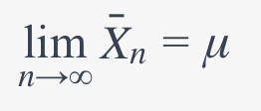
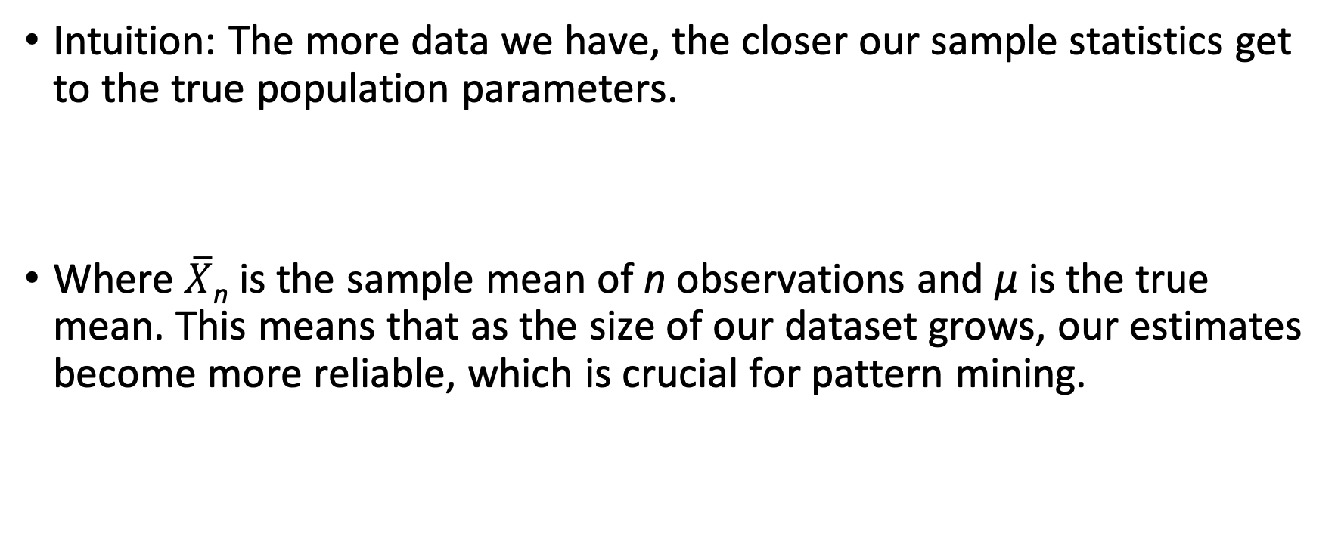
Law of Large Numbers
Intuition: The more data we have, the closer our sample statistics get to the true population parameters.
Where$\overline{X}$​_{n} ​is the sample mean of n observations and μ is the true mean. This means that as the size of our dataset grows, our estimates become more reliable, which is crucial for pattern mining.

Slide 22
Curse of Dimensionality
Intuition: As the number of features (or dimensions) grows, the volume of the space grows so fast that the available data becomes sparse. This sparsity is problematic for pattern mining methods that require statistical significance.
Volume∝(unit length)^{d}
Where d is the number of dimensions. As d increases, the volume grows exponentially, making the data sparse

Slide 23
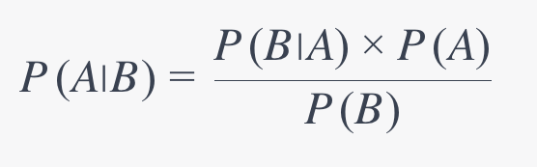
Bayes' Theorem and Prior Knowledge
Intuition: When mining patterns, sometimes prior knowledge about the domain can be crucial. Bayes' theorem provides a way to incorporate this knowledge.
Here, P(A∣B) is the posterior, P(A) is the prior, P(B∣A) is the likelihood, and P(B) is the evidence. By adjusting the prior, we can incorporate domain knowledge into our pattern mining algorithms.

Slide 24
Eigenvalues and Eigenvectors in Dimensionality Reduction
Intuition: For large datasets with many features, dimensionality reduction can help simplify the data without losing much information. The principal components of PCA are the eigenvectors of the data's covariance matrix, and they capture the directions of maximum variance.
Av=λv
Where AA is the covariance matrix, v is the eigenvector, and λ is the eigenvalue. Higher eigenvalues indicate more important directions of variance.

Slide 25
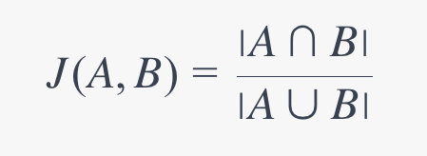
Jaccard Similarity for Set Comparisons
Intuition: When mining patterns in transactional datasets, we often deal with sets of items. To measure the similarity between two sets, the Jaccard similarity coefficient is useful.
Where AA and BB are two sets. The Jaccard coefficient measures the proportion of shared items to the total unique items between two sets. It's a useful metric for association rule mining.

